Slide 1
2022/23 Seasonal Influenza Vaccination
School Outreach (Free of charge)
2nd Briefing Session to Participating Doctors
31 August 2022
Notes:
歡迎出席2022/23季節性流感疫苗學校外展 （免費）計劃的簡介會

Slide 2
Rundown
TIME | CONTENTS
14:00 - 14:20 | Vaccination Procedures and Logistics Arrangements (Arrangements on the Vaccination Day)
14:20 – 14:30 | e-Reply Workflow
14:30 – 14:40 | Student Vaccination List and Claiming of Injection Fees
14:40 – 15:00 | Vaccine delivery logistic for School Programme and Preparations for Self-delivery of 2nd Dose Vaccine
15:00 – 15:10 | Clinical Waste Management
15:10 – 15:30 | Question & Answer Session

Slide 3
Vaccination Procedures
&
Logistics Arrangement
On the Vaccination Day

Slide 4
On the Vaccination Day
Roles and Responsibilities
Venue and Staff
Vaccine delivery (1st dose vs 2nd dose)
Vaccination Procedure
a. Check Consent (Paper / e-Consent)
b. Infection Control Practice
c. Vaccination Procedure
d. Documentation after Vaccination
e. Submitting Reports
Handling of Clinical Waste
Emergency Management
Handling of Vaccination Incidents
2nd dose preparation
Quality Assurance Inspection
Co-administration

Slide 5
Overall Role and Responsibility
It is the prime responsibility of the enrolled doctor in-charge of the arrangement/ healthcare provider and the organizer to give due consideration to safety and liability issues to ensure quality vaccination service delivered to recipients.
Make sure enrolled doctors can be reachable throughout the outreach activities.
Notes:
整體的角色和責任
要留意參與計劃的醫生需承擔安排整個活動的責任
所以他必須適當地考慮安全和責任問題
以確保為疫苗接種者提供優質的疫苗接種服務

Slide 6
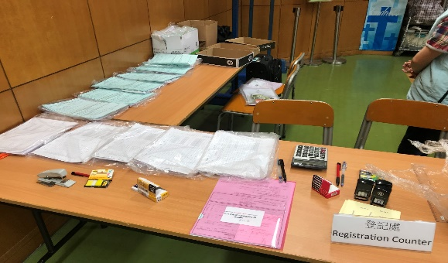
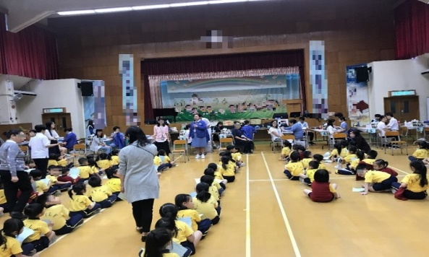
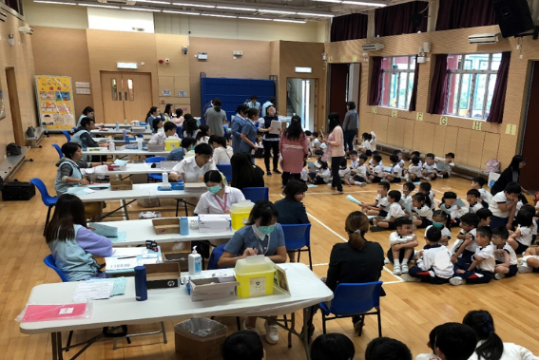
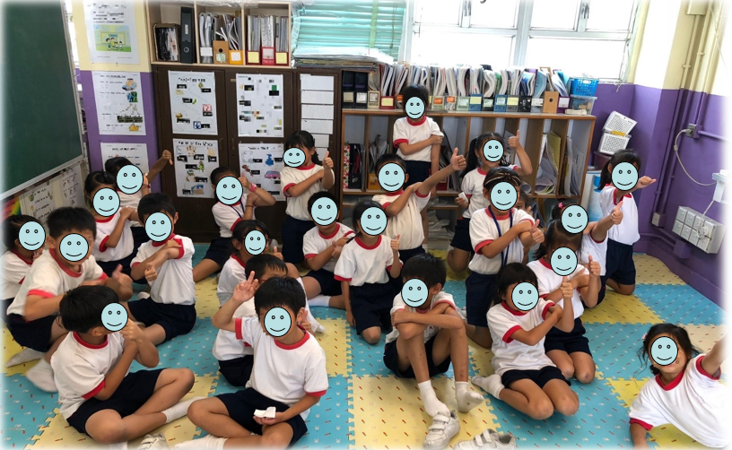
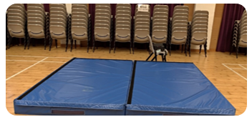
Venue and Staff
Venue
Clean, safe, privacy, good lighting and ventilation
Adequate and separate areas for the vaccine recipients
Registration Area
Waiting Area
Vaccination Area
Observation Area
Emergency Treatment Area with mattress

Slide 7
Infection Control Guideline
Health Advice to Schools for the Prevention of COVID-19 published on 28 April 2022 for more details: https://www.chp.gov.hk/files/pdf/advice_to_school_on_prevention_of_nid_eng.pdf
Interim Guidance for Routine and Influenza Immunization Services During the COVID-19 Pandemic. June 2021 https://www.cdc.gov/vaccines/pandemic-guidance/index.html

Slide 8
Venue - Infection Control Measures
The venue for vaccination should be kept well ventilated.
The venue should be cleaned and disinfected after every sessions with 1 in 99 diluted household bleach, left for 15-30 minutes, and then rinsed with water and wiped dry. For metallic surface, disinfect with 70% alcohol.
All attending students and staff should wear surgical mask at all times and practice hand hygiene.

Slide 9
Venue - Infection Control Measures
Check students’ and parents’ body temperature at school entrance (with alcohol handrub available).
Students should receive vaccination in a staggered manner (arranged in batches) to avoid crowding.
For IIV, maintain social distance of at least 1 meter between students, with mask on.
For LAIV, maintain social distance of at least 1.5 meter between students, when the mask is temporarily taken off.

Slide 10
2. Venue and Staff
Staff
Professional Staff
Sufficient number of qualified / trained healthcare personnel to provide service
Supporting Staff
Sufficient number
For administrative issues
Assist in positioning of recipients during vaccination
Suggested Manpower
Primary school | Kindergarten / Child Care Centre
At least 1 doctor / RN / EN to provide supervision on-site & at least 1 staff with first-aid training The PPP doctor is highly preferred to be present at the vaccination venue; If not, he/she should be personally and physically reachable in case of emergency.
One injection staff for One class | 1 injection nurse with 1 assistant for proper positioning of child

Slide 11
3. Vaccine delivery
For 1st dose SIVs:
- Deliver vaccines to Schools directly by DH appointed distributor ( DH delivery) to both PS & KG/CCC.
- Arrange designated staff to receive the vaccines.
For 2nd dose SIVs:
PPP doctors can choose either DH delivery or Self delivery.
If self-delivery is chosen, proper vaccine storage and maintain cold chain (within 2ºC to 8ºC) throughout the vaccination activity.

Slide 12
4. Vaccination procedures
Confirm with schools the vaccination list
Collect the List of Students who withhold Seasonal Influenza Vaccination from the teachers.
b) Check Consent (Paper / e-Consent)
Check vaccination history through eHS(S).
Check again the signed Consent Forms before vaccination; especially the vaccination history and the contraindication part.
c) Assess recipient’s fitness before vaccination

Slide 13
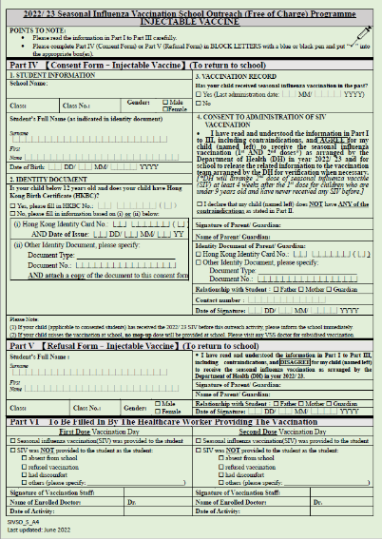
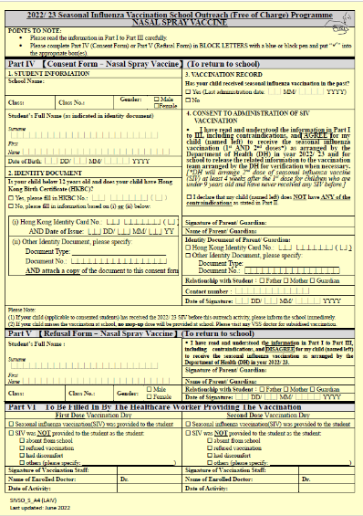
4. Vaccination procedures
Check Consent (Paper)
Parent agree for the child to receive
the seasonal influenza vaccination (1st AND 2nd doses)

Slide 14
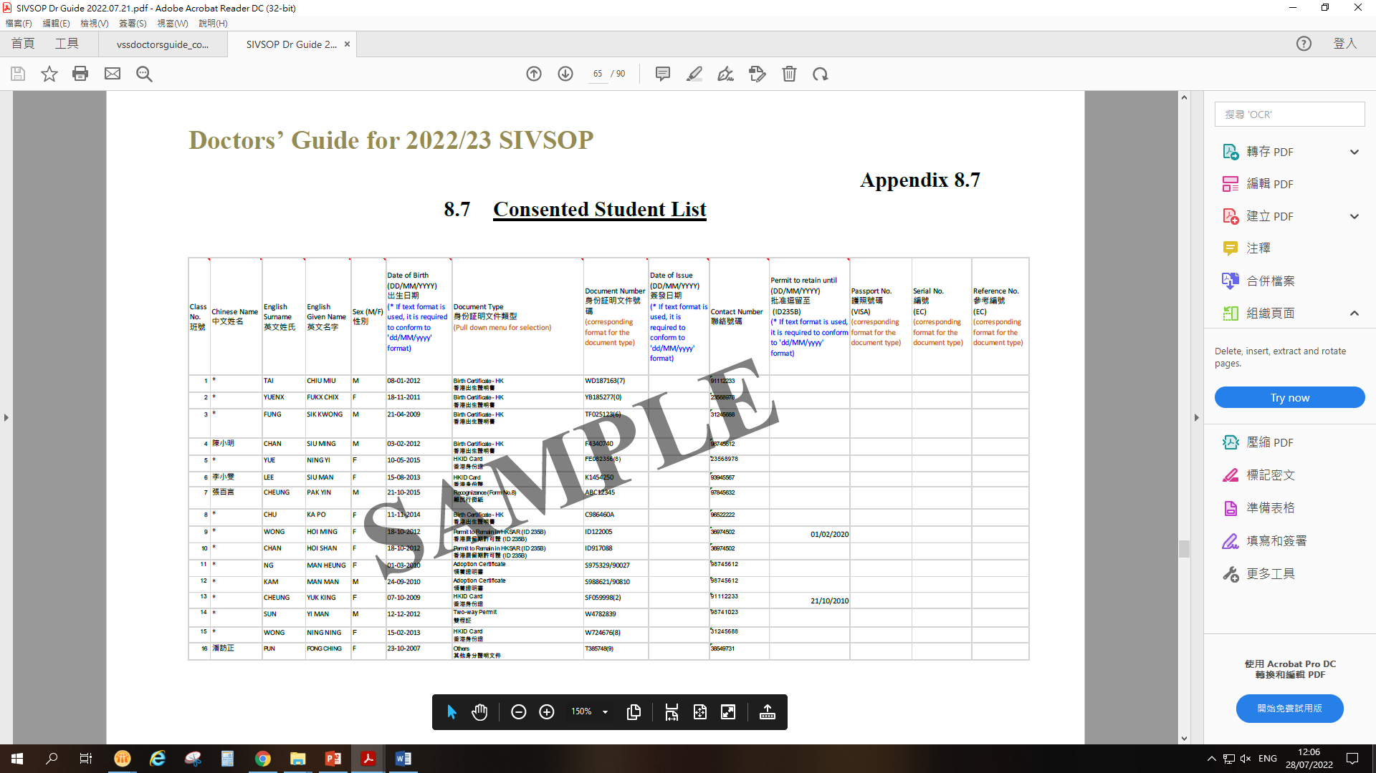
4. Vaccination procedures
Check Consent (e-Consent) [Pending]
Print out the “ Consented Student List” (Excel file) in advance for on-site checking.
Please be reminded of the following:
  Please make sure all the relevant items in the Excel table are filled in, especially the Type of identity document, Document number, Date of Birth, Date of Issue (if using HKID), Surname, Given Name, and Gender.
  For students who are holders of the Hong Kong Identity Card (HKID), the data of the HKID should be entered. It is necessary to enter the Date of Issue if using the HKID.
  If students are not holders of HKID, they may put down their information in their Hong Kong Birth Certificate, or other Identity Document (necessary to attach a copy of the other Identity Document)

Slide 15

4. Vaccination procedures
Infection control practice
i) Hand Hygiene - Use of 70-80% alcohol-based handrub (ABHR)
  when hands are not visibly soiled.
  ABHR should be in original packing &
  not expired.
ii) Hand Hygiene - Use of gloves
Wearing surgical gloves cannot replace hand hygiene.
If surgical gloves are used, they should be changed before each vaccination.
Hand hygiene should also be performed before putting on and after taking off the gloves.
Wear gloves when administering the LAIV

Slide 16
4. Vaccination procedures
Infection control practice
iii) Hand Hygiene Technique
Rub all hand surfaces (7 steps) including
  Palms
  Back of hands
  Between fingers
  Back of fingers
  Thumbs
  Finger tips
  Wrists
Rub for at least 20 seconds until hands are dry before and after vaccination.

Slide 17
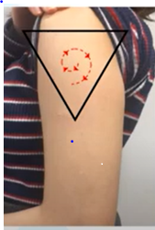
4. Vaccination procedures (for IIV)
Infection control practice
iv) Skin Disinfection (for IIV) & After Care
Use a sterile alcohol pad for skin disinfection before vaccination.
Wipe the area from the centre of the injection site outwards, without going over the same area.
Use a new clean gauze / cotton wool ball for post vaccination compression of injection site.

Slide 18

4. Vaccination procedures (for LAIV)
Infection control practice
v) Wear mask & gloves, proper hand hygiene
LAIV administration is not considered as an aerosol-generating procedure. (N95 or higher-level respirator is not necessary)
Vaccination teams should wear surgical mask and gloves when administering the LAIV.
The gloves should be changed after administration of LAIV to each student.
Perform hand hygiene after removing the previous gloves, and before wearing the new gloves.
During nasal spray vaccine administration when mask is temporarily taken off, maintain social distance of at least 1.5 m.
After the procedure, practice hand hygiene and wear mask as soon as practicable.
According to CDC (https://www.cdc.gov/vaccines/pandemic-guidance/index.html)

Slide 19
4. Vaccination procedures
Vaccination
Check the recommendation (in drug insert), vaccine dosage, damage, contamination and expiry date.
3 checks:
  When taking out the vaccine from storage
  Before preparing the vaccine
  Before administering the vaccine
7 rights:
  Recipient
  Vaccine
  Time (e.g. correct age, correct interval, vaccine not expired)
  Dosage
  Route, needle length and technique (refer to drug inserts)
  Injection Site
  Documentation
Keep the vaccinated students under observation for at least 15 minutes.

Slide 20
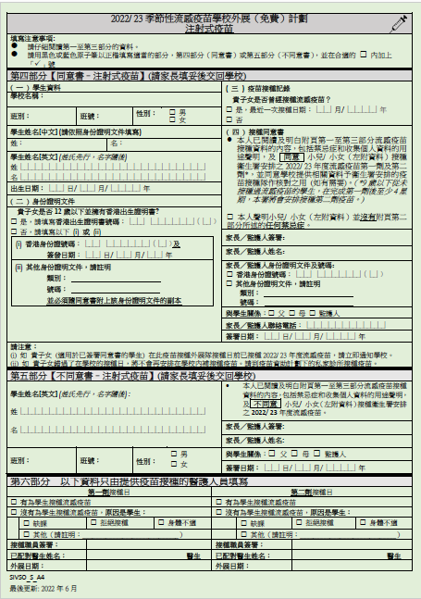
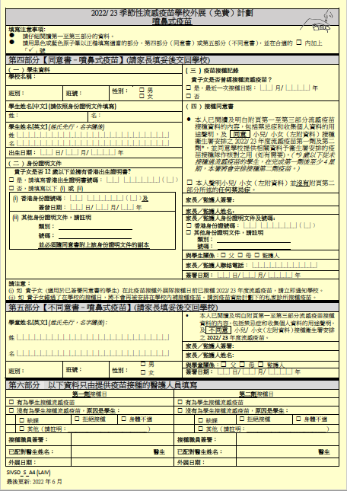
4. Vaccination procedures
Documentation after vaccination
i) Record the vaccination details on the consent form
Provide name and signature of the medical service provider on the Consent Form after vaccination.
Fill in all information in relevant column.
Name of enrolled doctor on the consent form should be same as
the Doctor in Enrolment Form

Slide 21
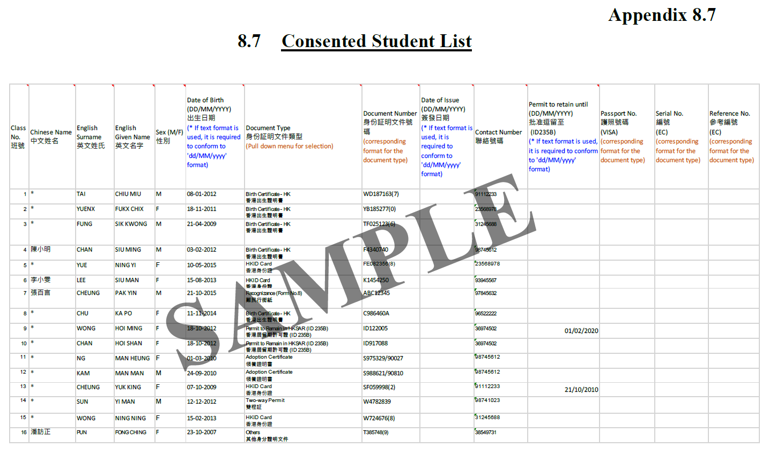
Vaccination procedures
  Documentation after vaccination
  ii) Complete the consented student list
ALL vaccinated students should be documented with vaccination date on the Consented Student List .
2nd dose vaccination for Students under 9 years of age who have never received SIV before.
  Arrange at an interval of at least 4 weeks after the first dose.
  Provide 2nd dose SIV Student List to school.

Slide 22
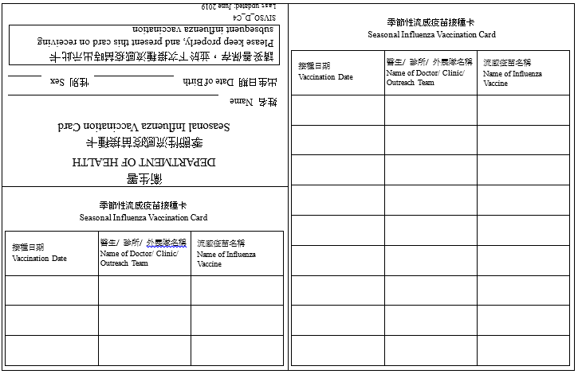
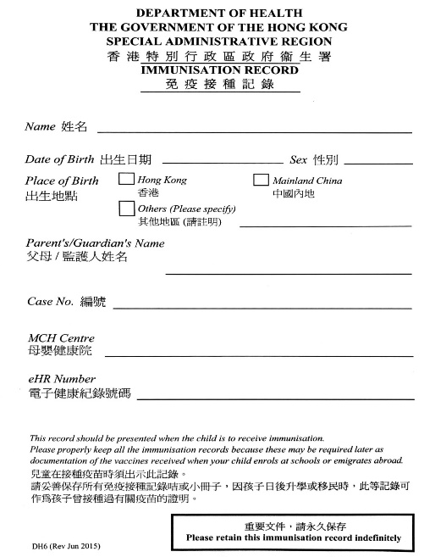
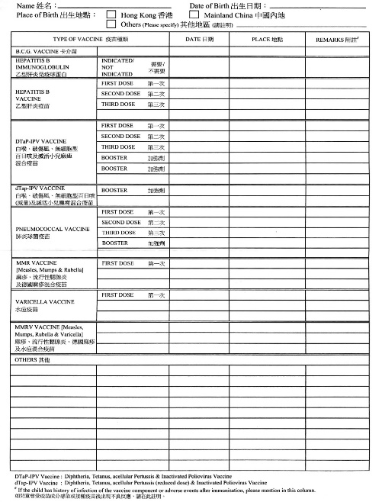


4. Vaccination procedures
  Documentation after vaccination
iii) Fill in vaccination card, do not use DH6.
Stamp on the old / new Seasonal Influenza Vaccination (SIV) card
✓✓ Issue new SIV card
XX DO NOT STAMP on DH6
15/11/2022
Either Name of matched Medical Organization OR Name of enrolled doctor

Slide 23
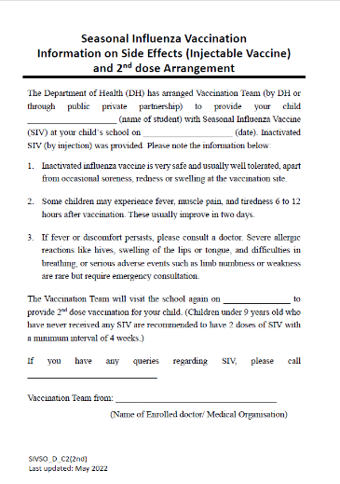
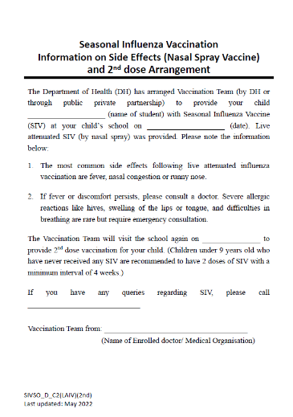
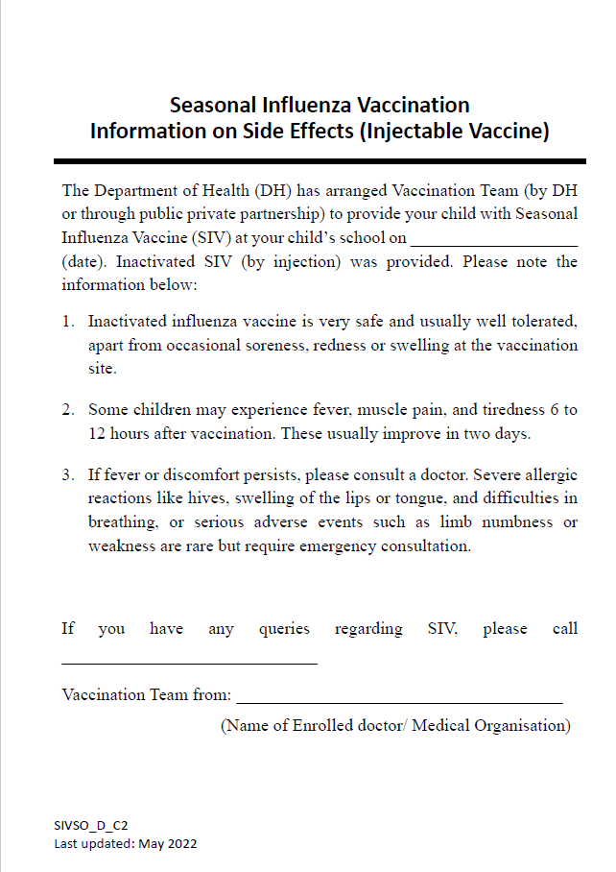
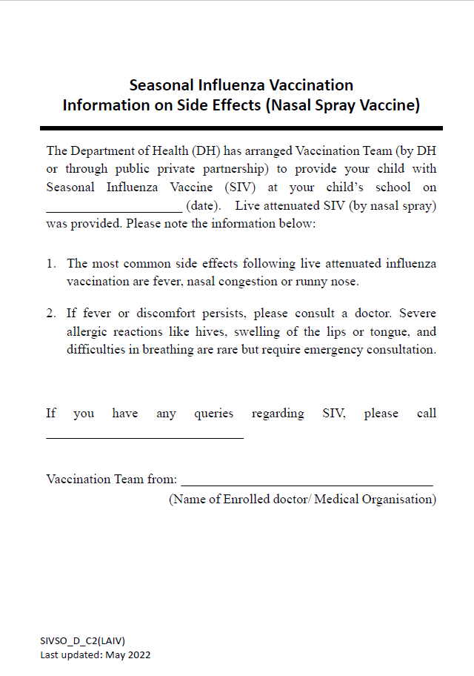
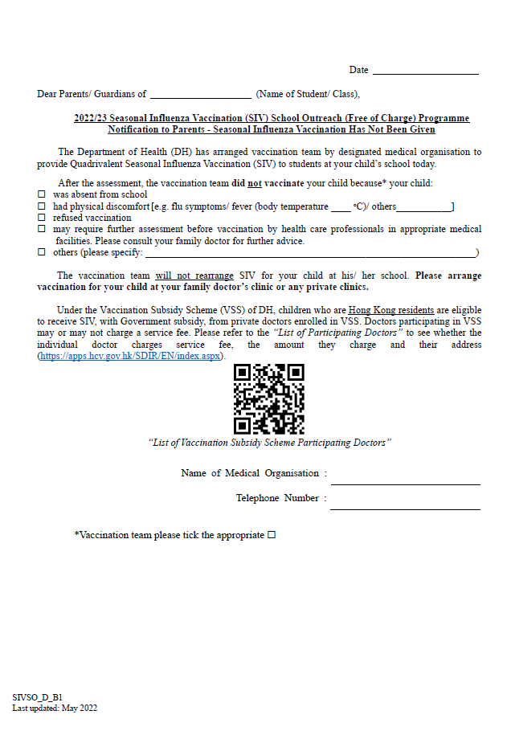
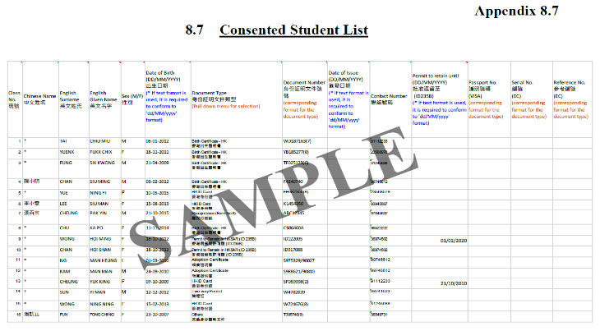
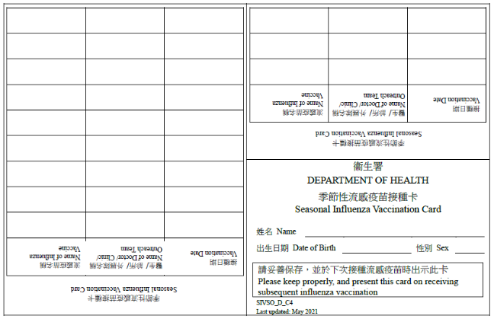
UPON COMPLETION OF VACCINATION
Documents to students
Need 2nd dose vaccination
Do not need 2nd dose vaccination
No vaccination on the vaccination day

Slide 24
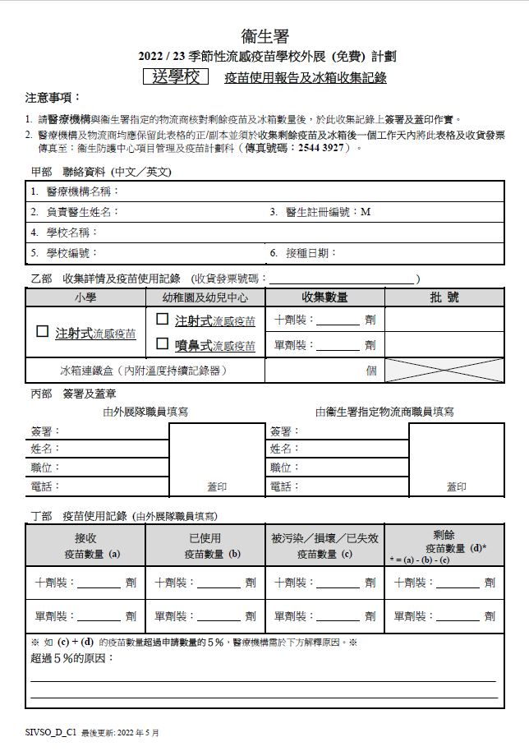
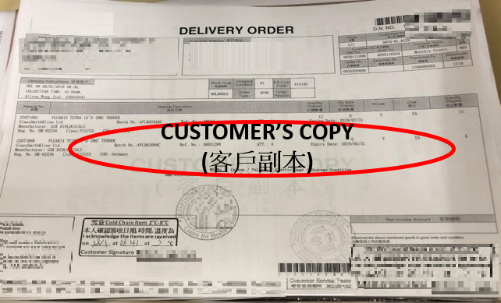
4. Vaccination procedures
  Submitting Reports (For DH delivery)
  Within 1 day after vaccination: Fax “Vaccine Delivery Note” & “Vaccine Usage Form- DH delivery” to PMVD

Slide 25
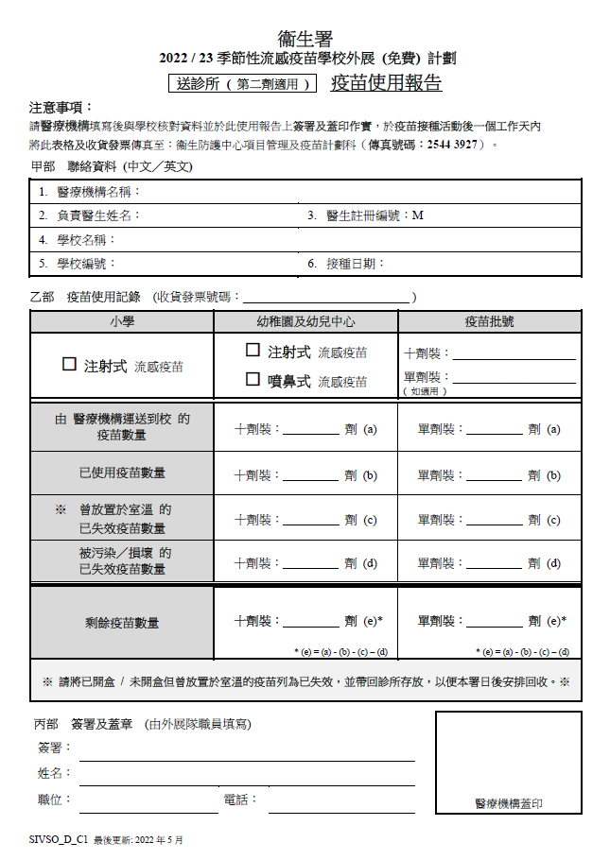
4. Vaccination procedures
  Submitting Reports (For Self-delivery)
  Within 1 day after receiving vaccines: Fax “Vaccine Delivery Note” to PMVD
  Within 1 day after vaccination: Fax “Vaccine Delivery Note” & “Vaccine Usage Form- Self Delivery” to PMVD

Slide 26
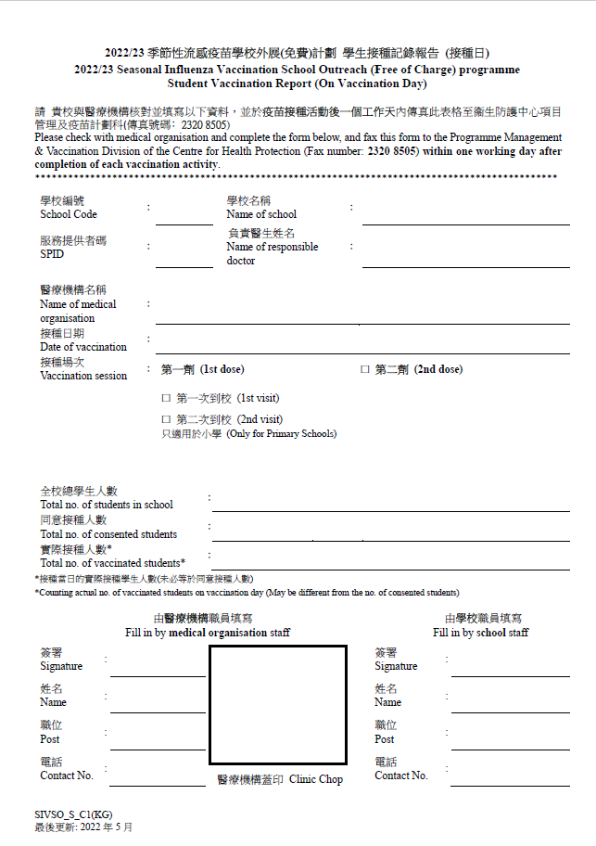
4. Vaccination procedures
  Submitting Reports
  Fax the following form to PMVD within 1 day after vaccination
  by school
Medical organization should liaise with school staff concerning vaccine usage, and fill in this form on same day after vaccination
School staff fax this form to PMVD within one day after vaccination

Slide 27
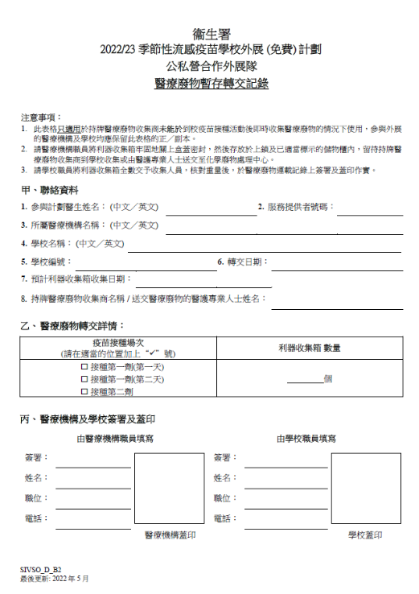
5. Handling of clinical waste
Discard the used syringes and uncapped needles directly into sharps box.
Place the sharps box on a flat, firm surface and at an optimal position near the injection staff.
Dispose sharps box when the disposable sharps reach the warning line (70-80%) for maximum volume.
Seal up sharps box afterwards for proper disposal.
(Please refer to guidelines of the Environmental Protection Department)
Complete the Clinical Waste Temporary Storage Handover Note
  (Appendix 8.19 of 2022/23 SIVSOP Doctors’ Guide, if temporary storage at schools is required.)

Slide 28
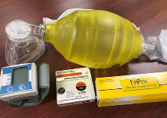
6. Emergency management
Staff
- Arrange qualified personnel with emergency management qualifications on-site such as Basic Life Support.
- Keep training up-to-date and under regular review.
- The PPP doctor is highly preferred to be present at the vaccination venue; he/she should be personally and physically reachable in case of emergency.
Equipment
- Protocol for emergency management
- Emergency kit equipment should include, but not limited to:
    Bag-Valve-Mask (age-appropriate size)
    BP monitor (age-appropriate cuffs)
    At lease three Registered Adrenaline auto injector/ ampoules (1:1000 dilution)
    Syringes and needles suitable for IMI adrenaline administration
    (at least three 1 ml syringes with three 25-32mm needles)
    - Keep sufficient stock
  Area
  - Designate an area for emergency treatment (with mattress)
Not expired
    Monitoring and Management of Adverse Events Following Vaccination
    (Appendix F of 2022/23 Vaccination Subsidy Scheme (VSS) Doctors’ Guide)

Slide 29
7. Handling of Vaccination incidents
Record the child’s condition and manage immediately.
Explain to the teacher and parents timely.
Notify PMVD ASAP at 2125 2128.
Submit Clinical Incident Notification Form (Appendix 8.22)
to PMVD via email within the same day.
Submit Clinical Incident Investigation Report (Appendix 8.23)
to PMVD via email within 7 days.

Slide 30
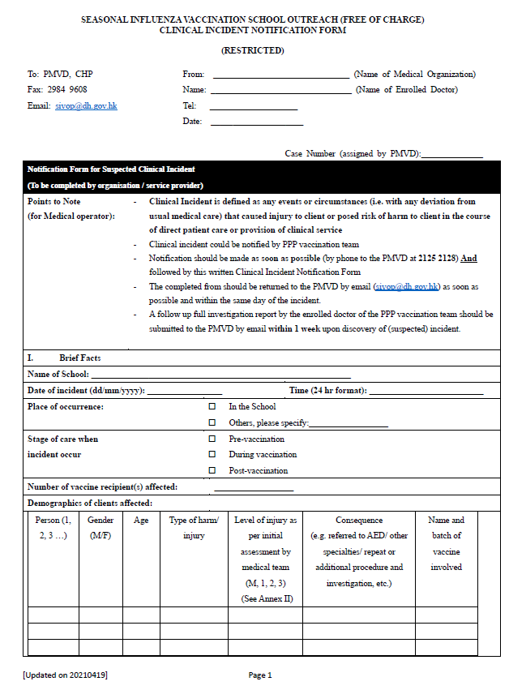
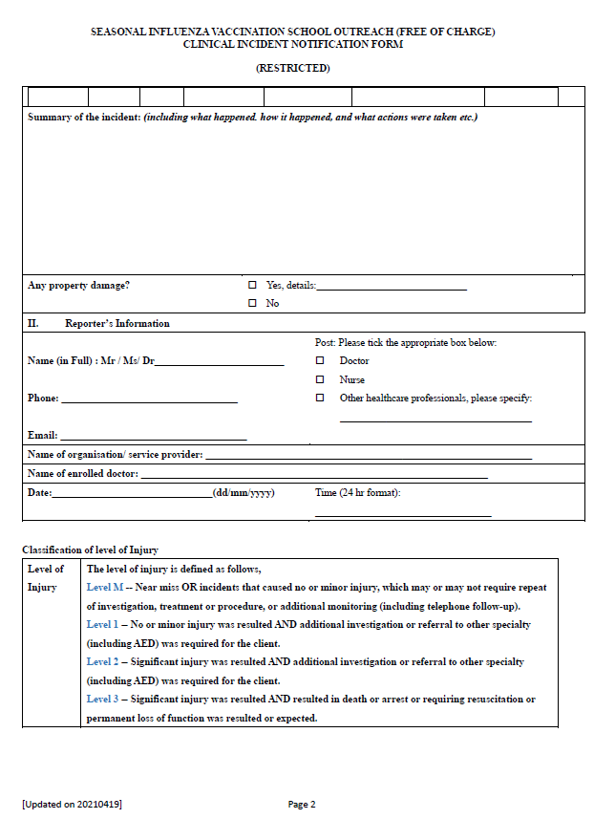
7. Handling of Vaccination incidents
Sample of Clinical Incident Notification Form

Slide 31
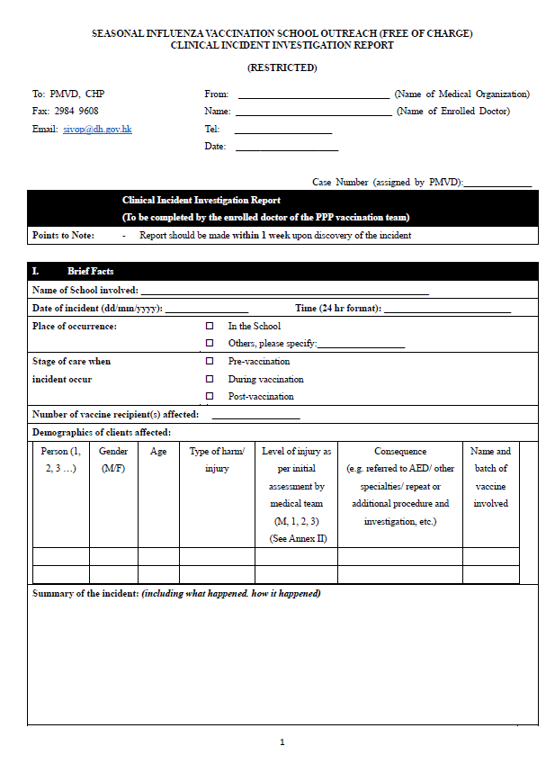
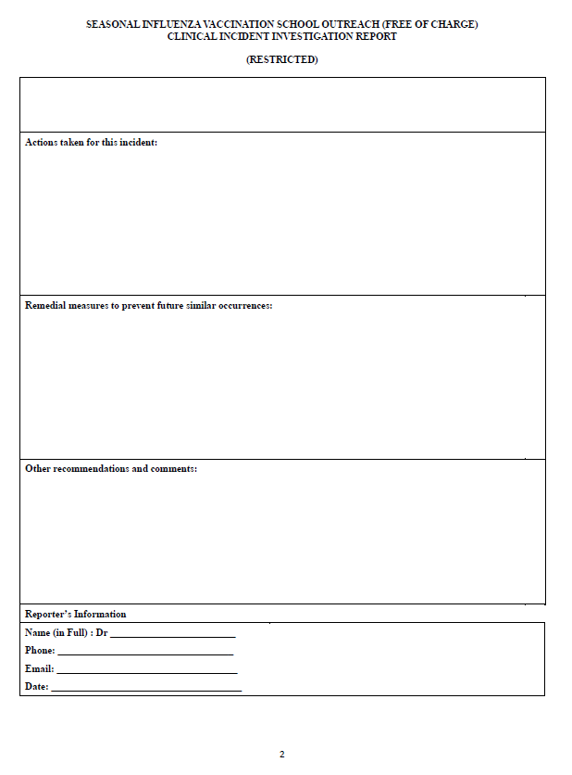
7. Handling of Vaccination incidents
Sample of Clinical Incident Investigation Report

Slide 32
8. 2nd Dose Preparation
Check the consent form for the vaccination history provided by the parents/guardians in addition to the record on eHS(S)
The vaccination record on eHS(S) may not show all vaccination history, e.g. the vaccine recipient may have received seasonal influenza vaccination overseas / through self payment by private doctors and it will not be shown on eHS(S)
If the vaccination history provided by parents/guardians and the eHS(S) records are inconsistent, please clarify with the parents/ guardians.

Slide 33
9. Quality Assurance Inspections
Venue setting
Cold-chain management
Vaccination procedure and techniques
Emergency equipment preparation
Clinical waste management
Notes:
SIV: 154 in 2021-22 (increased by 12 %)
COVID: 497 nos. of inspections on COVID-19 vaccination programmes (from 2/2021 to present) (including CVCs, Outreach, VSS Pilot Scheme, etc.)

Slide 34
Observations and Recommendations
Areas | Observations | Recommendations
Venue setting | Mixing consent and non-consent students in the same activity venue Mixing vaccinated and non-vaccinated students in the same venue | Only allowed consent students to stay in the vaccination room Clear segregation - by signage, partition - by supporting staff
Cold chain management | Temperature of the fridge/cold box for vaccine storage was not closely monitored Absent of appropriate temperature monitoring device for cold-chain management. | Monitoring the temperature for vaccine storage with max-min thermometer/data logger

Slide 35
Observations and Recommendations
Areas | Observations | Recommendations
Vaccination procedure and technique | Improper identity and consent form checking Improper positioning of children Improper hand hygiene technique | Checking at least two identifiers and eligibility of recipient before vaccination - in particular 2nd dose - check information in both eHS(S) and consent form Give instruction to parents on positioning properly Adhere to 5 moments and 7 steps of hand hygiene technique
⬇ Strictly Adhere 3 checks and 7 rights for vaccine administration ⬇

Slide 36
Observations and Recommendations
Areas | Observations | Recommendations
Emergency equipment preparation | Expired Adrenaline Inappropriate syringe and needle No age-appropriate BP cuff / BVM | Check and prepare size and age appropriate emergency equipment before activity
Clinical wastes management | Overfilled sharps box Inappropriate storage area | Change new sharps box when ¾ filled Adhere to the EPD guidelines and regulations

Slide 37
10. Co-administration
The Hong Kong Paediatric Society, The Hong Kong Society for Paediatric Immunology, Allergy and Infectious Diseases, the Hong Kong College of Paediatric Nursing and the Hong Kong Paediatric Nurses Association issued a joint statement on 30th August 2022, appealing to parents and carers for COVID-19 Vaccination in infants 6 months and above, children and adolescents to prevent acute complications, hospital admissions, severe disease, fatality, medium and long-term sequelae resulting from COVID-19 infection.
They emphasized that the most effective way to prevent the occurrence of "Multisystem Inflammatory Syndrome in Children" and "Long COVID" is to allow the children to receive the recommended number of doses of COVID-19 vaccination.
http://www.medicine.org.hk/hkps/download/20220830%20Appealing%20to%20Parents%20and%20Carer%20for%20COVID%20Vaccination%20in%20Children%20and%20Adolescents_eng.pdf

Slide 38
10. Co-administration
COVID-19 vaccines can be co-administered with, or at any time before or after, any other vaccines including live attenuated vaccines under informed consent.
If parents of children wish to space out COVID-19 vaccine with live attenuated vaccines (e.g. Measles, Mumps, Rubella & Varicella (MMRV) Vaccine; Live Attenuated Influenza Vaccine (LAIV)), an interval of 14 days is sufficient.

Slide 39
10. Co-administration
Please note the requirements for COVID-19 Vaccination outreach arrangement are different to SIV outreach, particularly:
  Pre-requisite: If PPP doctor wishes to provide COVID-19 vaccination at outreach, the doctor should be also enrolled in the COVID-19 VSS non-clinic setting
  Advance liaison with schools to obtain consent from parents
  COVID vaccination outreach requires an on-site doctor
  Doctors are responsible for delivering the COVID-19 vaccines to the venue
  Computers are required to input personal particulars on-site
  Printers are required to print the vaccination records to the vaccine recipients on-site

Slide 40
10. Co-administration
If different types of vaccines are provided together in one outreach activity, please ensure that involved staff are well trained to handle various vaccines at the same time properly
  Particular attention should be paid to clear segregation of clients and booths administering different types of vaccines, proper vaccine and vaccination record handling, and collection of appropriate consent from parent/ guardians on respective vaccines and co-administration

Slide 41
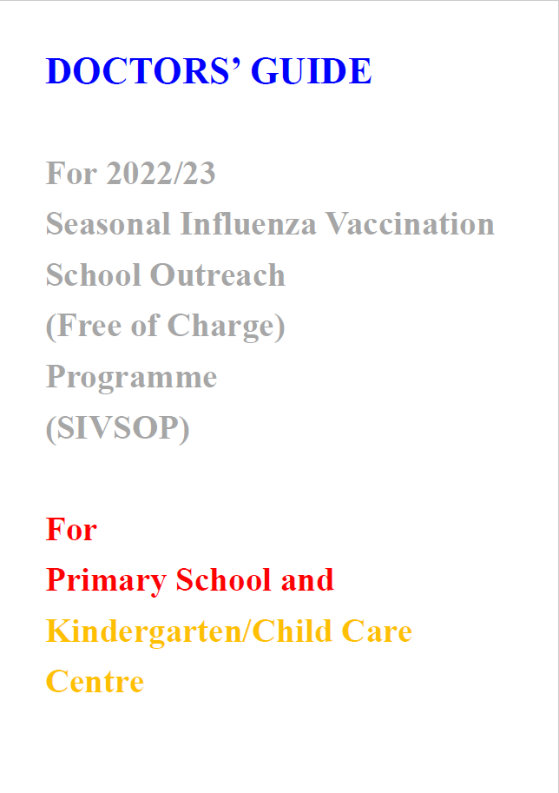

Please read and follow both guides when providing outreach vaccination activities
Check the latest version at CHP website http://www.chp.gov.hk
2022/23
Pending

Slide 42
Thank You!

